Slide 1
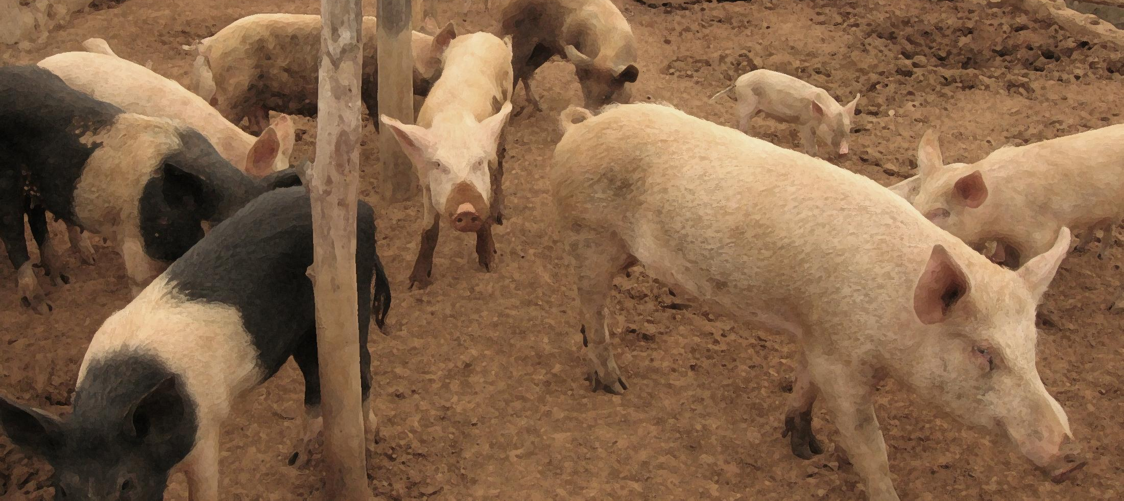

A One Health approach to the spatial epidemiology of tapeworm in rural Kenya:
Linking human and animal health
Dr Nicola Wardrop
Senior Research Fellow

Slide 2
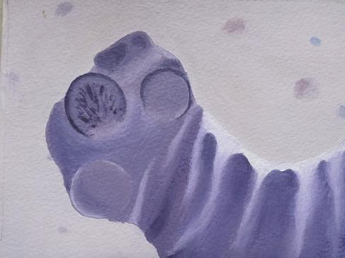
Background
Zoonotic diseases
  Transmit from animals to humans
  Burden on animal and human health
  Agricultural losses
One Health approach needed for control
Still significant gaps in understanding

Slide 3
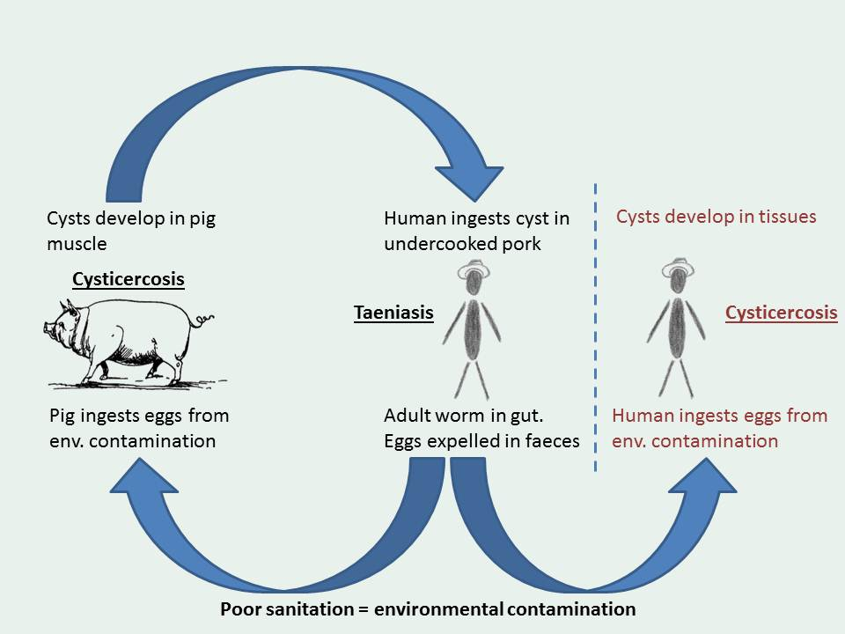
Pork Tapeworm
Taenia solium

Slide 4
Background
Distinct disease outcomes
  Human taeniasis
  Human cysticercosis
  Pig cysticercosis
Previous detection of spatial clustering
  Possible environmental drivers (widely accepted for other similar diseases)
Presumed spatial overlap

Slide 5
Aims
Develop analysis framework for integration of human and animal health outcomes
Examine evidence of spatial overlap between human and pig infections
Assess the potential role of environmental factors in the spatial distribution of human and pig infections

Slide 6
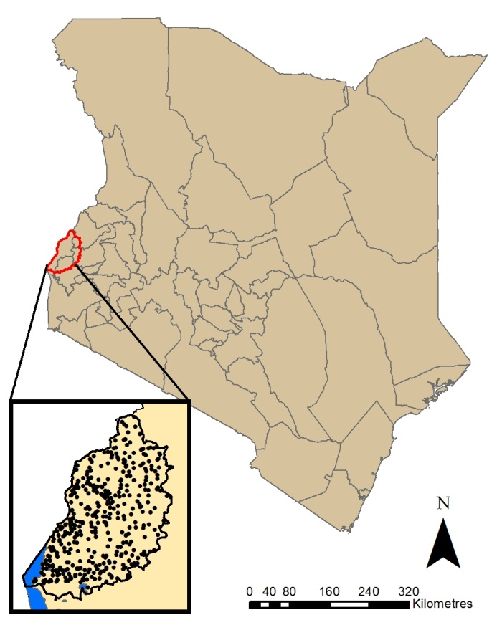
Methods
416 households
2113 humans
  Taeniasis
  Cysticercosis
93 pigs
  Cysticercosis

Slide 7
Methods
Exploratory spatial analysis
  Assessment of spatial concurrence
  Bivariate kernel density estimation (spatially smooth relative risk surface)
  Spatial cluster detection
Regression analysis
  Assess importance of individual and household level factors (including environment)

Slide 8
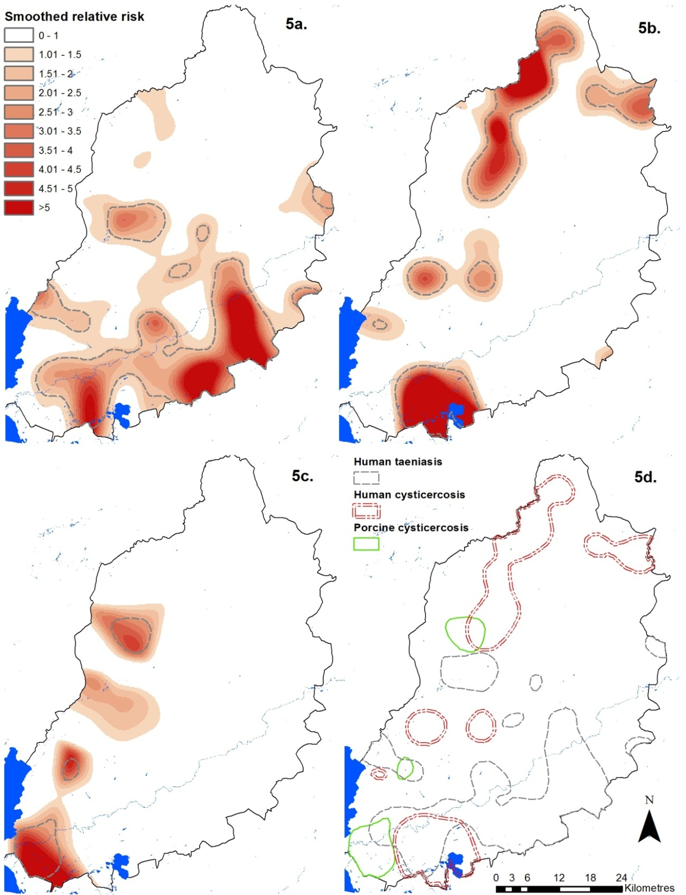
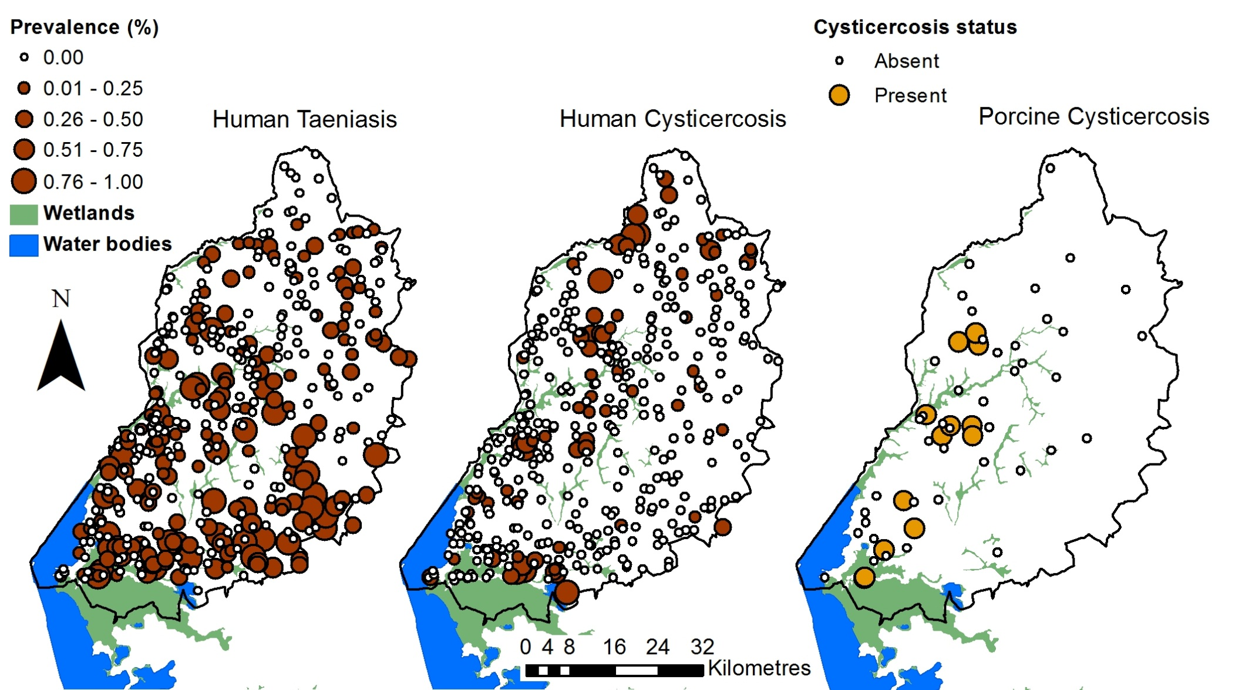
Results
Clear areas of elevated risk
Some overlap, but not widespread

Slide 9
Results
Human taeniasis
Covariate | OR | p-value
Intercept | 0.003 | <0.005
Level 1 covariates
Tribe
Luhya | 1
Luo | 1.77 | 0.02
Samia | 0.68 | 0.24
Teso | 0.38 | 0.004
Other | 0.97 | 0.98
Pork frequency
Weekly | 1
Less often | 0.79 | 0.28
Never | 0.63 | 0.06
Level 2 covariates
Vegetated (%) | 1.04 | 0.01
Cultural practices (e.g. meat eating, sanitation)
Infection via eating infected meat
Indirect effect on egg viability?

Slide 10
Results
Human cysticercosis
Covariate | OR | p-value
Intercept | 0.002 | <0.005
Level 1 covariates
Gender
Female | 1
Male | 0.59 | 0.02
Education
None | 1
Primary | 0.62 | 0.09
Secondary | 0.69 | 0.39
Above | 0.81 | 0.77
Level 2 covariates
Well water
No | 1
Yes | 3.45 | 0.004
Crops & grassland | 1.03 | 0.06
Precipitation | 0.998 | 0.004
Behaviour and exposure
Related to knowledge & practices
Contamination
Egg survival or probability of exposure

Slide 11
Results
Pig cysticercosis (single level model)
Covariate | OR | p-value
Intercept | 0.09 | <0.005
Breeding sows
Male | 1
Non breeding sow | 0.70 | 0.57
Breeding sow | 10.35 | 0.01
Flooding crop & grassland | 1.04 | 0.004
Length of exposure
Egg survival or probability of exposure

Slide 12
Discussion & conclusions
Good example of One Health analysis
Spatial clustering, but not much overlap
Some evidence of environmental influences
Limitations
Small sample size for pig infections
Spatial density of sampling

